Slide 1
BLOOM
AKHILESH R MOHAN
SURYA K N
S AARON DENNIS
CO-FOUNDERS
8/12/2022

Slide 2







BLOOM
WHAT IS BLOOM
One stop solution to register into an scheduled event in a fast and convenient way
Industry expert
BLOOM
BLOOM
A service providing company where we aim to provide quality content of knowledge to our audience through industry expert talks at scheduled dates
8/12/2022

Slide 3
bloom
BUISNESS MODEL
A tech event management company typically operates by providing services to clients looking to host tech-related events such as conferences, workshops, and trade shows. The company offers a range of services including event planning, venue selection, logistics management, and marketing.
The company typically operates with a team of event planners, coordinators, and marketing specialists who work together to plan and execute successful tech events for their clients. The company's success is measured by the satisfaction of their clients and the success of the events they produce.

Slide 4

Tech stack
Nodejs
express
mongo dB
react
html
CSS
JavaScript

Slide 5
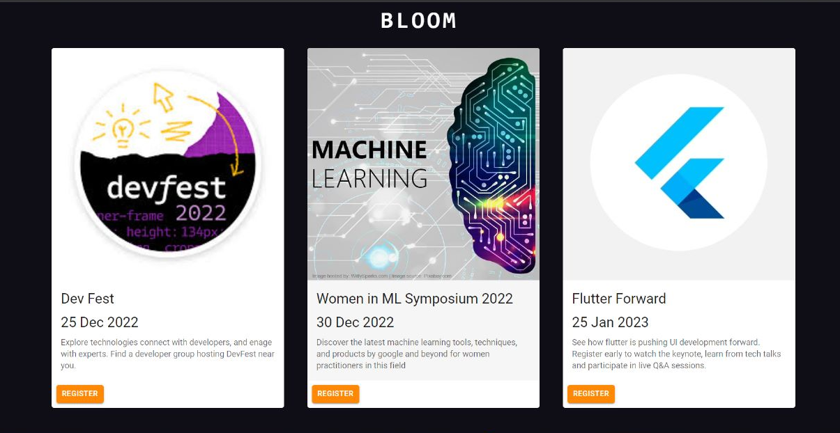
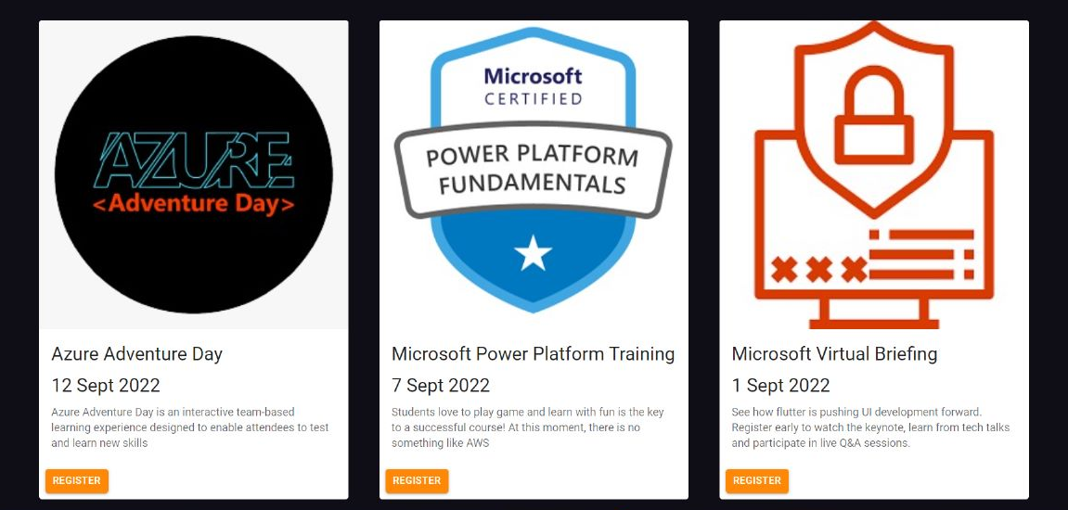
bloom
FEATURES OF BLOOM
The courses we provide:-

Slide 6
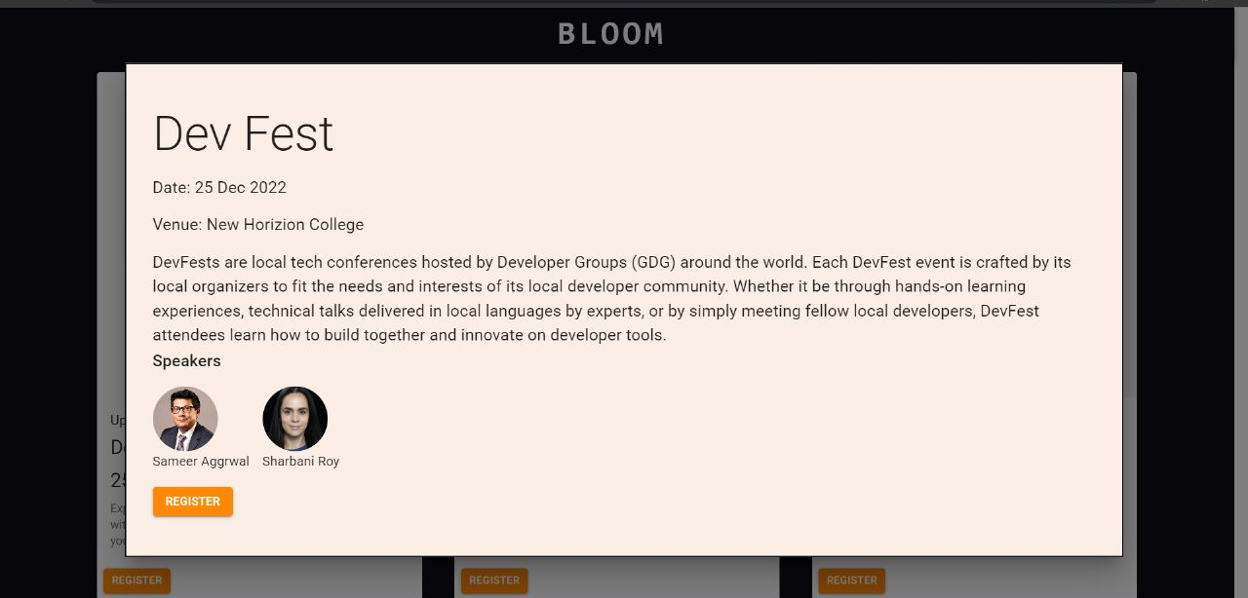
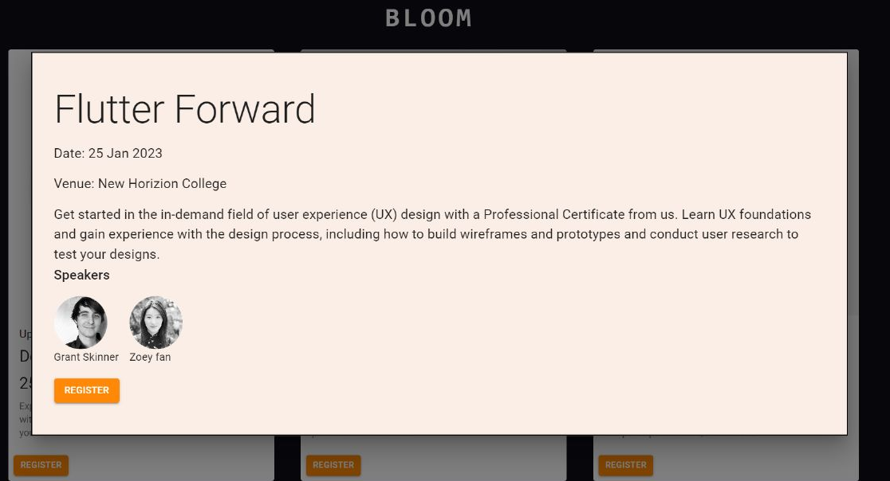
bloom
The user inter-face for registering

Slide 7
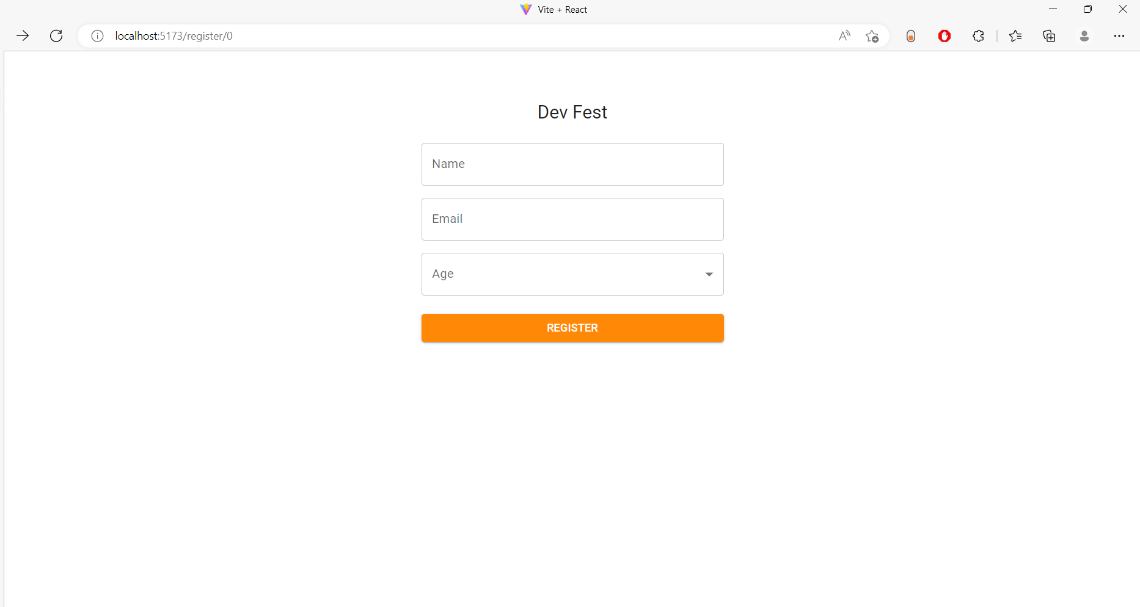
bloom
REGISTERING PAGE

Slide 8
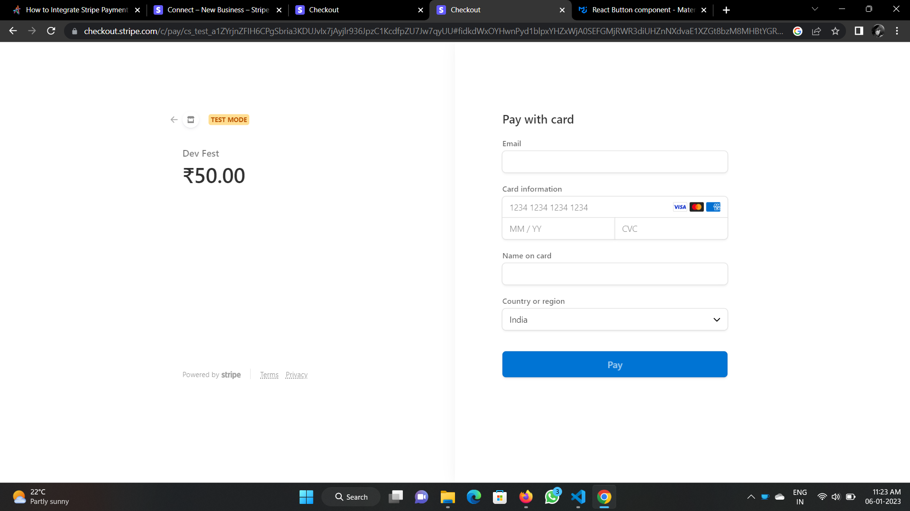
bloom
PAYMENT GATEWAY

Slide 9
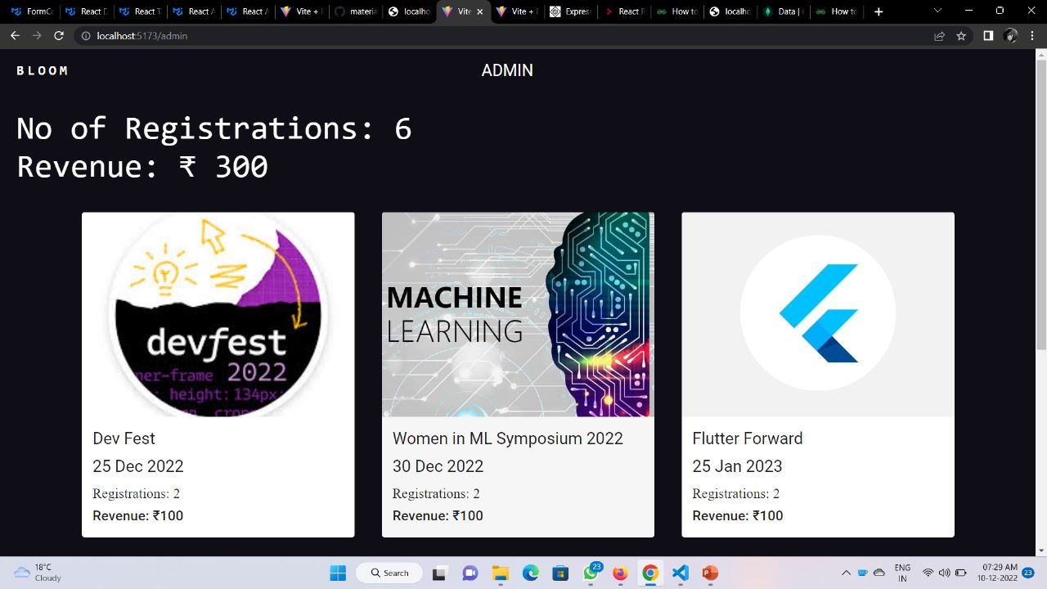
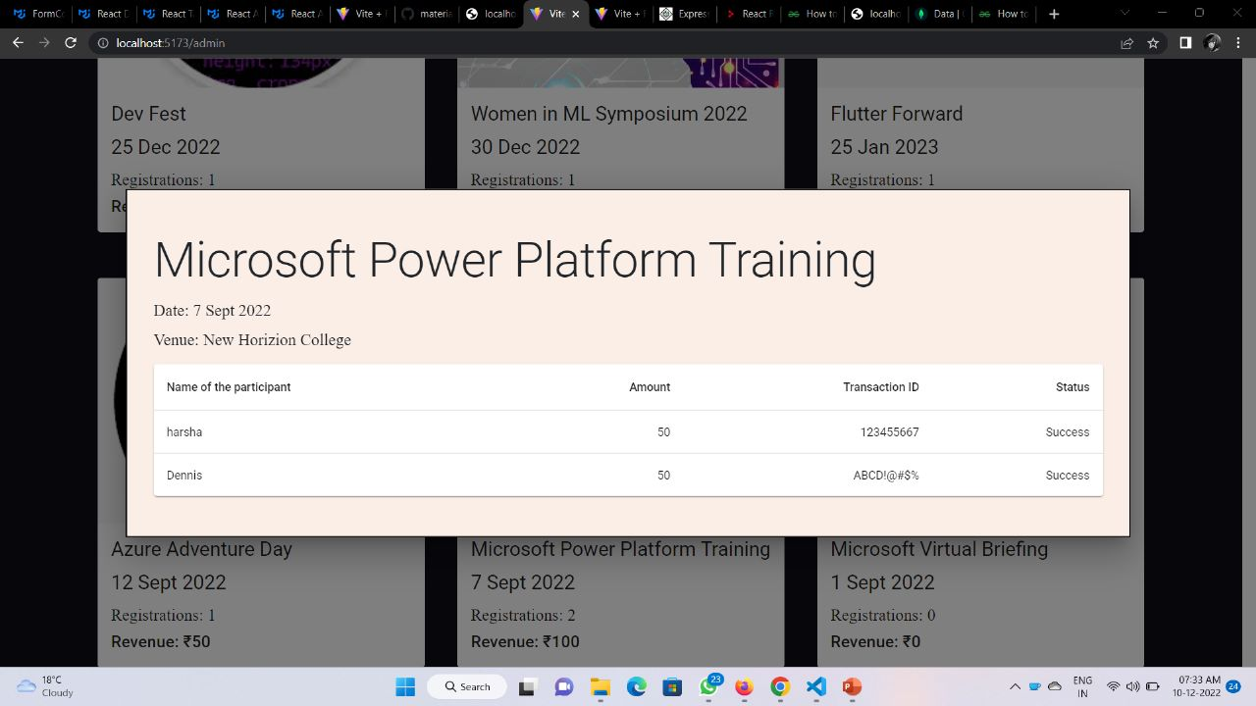
bloom
The admin user interface

Slide 10
BLOOM
AKHILESH R MOHAN
SURYA KN
S AARON DENNIS
THANK YOU!

